Slide 1
Engineering Uncertainty
Unit 2
Fall 2022

Slide 2
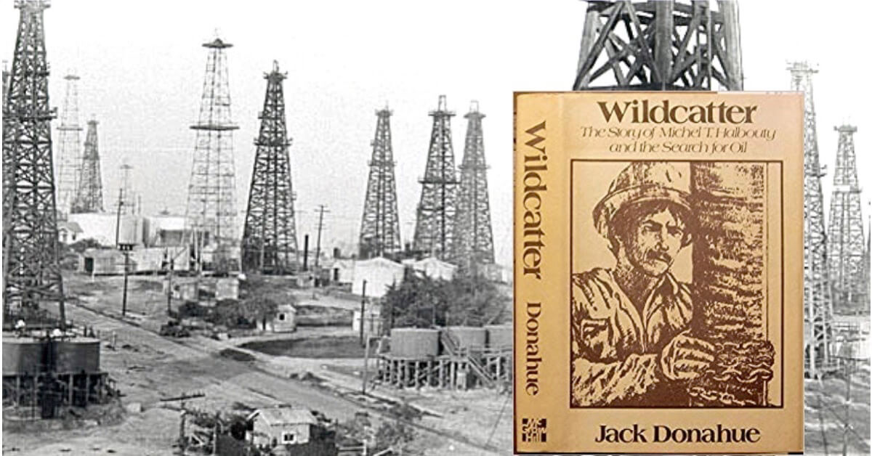
Decisions of an Oil Wildcatter
A wildcatter is an individual who drills wildcat wells, which are exploration oil wells drilled in areas not known to be oil fields.
Decision to drill involves significant costs, but a decision not to drill can result in significant lost profits. At risk are monetary costs and profits.

Slide 3
To Drill or Not to Drill!
Uncertainties and risks affecting decisions of oil and gas operators, including:
Uncertainty in the probability of success in striking oil
Flow from well can vary over wide ranges (high uncertainty)
Flow of oil or gas can decrease greatly over time ( also high uncertainty)
Drilling operation can be difficult (costs are uncertain)
Decision of whether to drill at a site before the site lease expires

Slide 4
Wildcatter Decision Tree models a scenario of events following a decision
highest value (utility) due to oil flow
Decision Tree
θ₁, oil
u_{max}
decision node
uncertain node
α₁, drill
lowest value (utility) due to drilling costs but no oil
θ₂, no oil
u_{min}
U utility
Decision
θ₁, oil
u₃
α₂, not drill
u_{max} > u > u_{min}
θ₂, no oil
u₄
Utility of each outcome, U, could be estimated by a monetary value, $, for each θ.

Slide 5
Oil Wildcatter EMV, Student Exercise
θ₁ : oil
$10 M
Expected $ value of α₁
0.25
α₁ : drill
θ₂ : no oil
– $1.5 M
0.75
Risk losing $1.5 M
Expected $ value of α₂
α₂ : not drill
$1M
Value of lease due to potential of oil

Slide 6
Oil Wildcatter EMV, Solution
θ₁ : oil
$10 M
Expected $ value of α₁
$1.4
0.25
α₁ : drill
θ₂ : no oil
$1.4
– $1.5 M
0.75
Risk losing $1.5 M
$1M
Expected $ value of α₂
α₂ : not drill
$1M
Value of lease due to potential of oil
A decision in this case would favor contract α₁ , which has the larger expected monetary value of $ 1.375 M.

Slide 7
Lower Uncertainty for Drilling Decision
The wildcatter can benefit from Expert Judgment by hiring a geologist to estimate the probability of oil, P(θ₁), at the leased site based on rock structure and other characteristics and conditions.
This case demonstrates the Value of Information (VI or VOI) gained from a test or additional information to lower uncertainty (and risk) of outcomes and to make a better or optimum decision supported by more evidence.

Slide 8
Oil Wildcatter Decision Exercise
To obtain an estimate for the probability of oil, the wildcatter consults a geologist. Based on data or information, the probability of oil, P(θ₁), could be low enough that the EMV for the alternative not to drill, α₂ , would be larger than the EMV for the alternative to drill, α₁ .
As an exercise, calculate the threshold probability of oil, P(θ₁), for which the EMV of the two decision alternatives become equivalent. Below this probability value, the EMV of alternative α₂ , not to drill, would be favored.
Ans: P(θ₁) = 0.217
Notes:
EMV=Expected monetary value

Slide 9
Location of a Railway Through a City
Decision making is needed for location of a railway through a city that transports rail cars containing chlorine, which could leak chlorine vapor or release chlorine liquid.
With relocation of the railway at great expense, potential exposure during a release and therefore risk of exposure could be significantly reduced with consequences of upsets less severe.
This example illustrates engineering decisions to select alternatives based on a balance between risk and return (profits – costs). Decisions can also involve other criteria, such as performance and effect on the environment. So the balance can be expressed as risk and return with return the sum of values and costs (direct and indirect).

Slide 10
Rail Relocation Decision Tree
high
deaths & injuries
uncertain amounts:
amount
θ₁, Cl₂ release
Location 1
α₁, relocate
low
injuries
θ₂, no Cl₂
θ₃, no Cl₂
α₂, do not relocate
deaths & injuries
high
θ₄, Cl₂ release
amount
Location 2
injuries
low
(Jordaan, Fig 1.3)

Slide 11
Rail Relocation Tree Information
As in all decision making, the optimum alternative is based on the Maximum Expected Value or Utility.
This is another example of the Value of Information, VI, obtained from tests or information from previous incidents or expert judgment to lower uncertainty and risk and make a better decision.
The information to support a decision will lead to estimates of gas release Probability Range or Distribution, P(θ), for each of the decision alternatives: relocate, not relocate.
Also, information to support a decision will result in estimates of outcome Consequence Range or Distribution of gas release based on people and conditions at each location, for each decision alternative.

Slide 12
Expected Value and Decision
Assume two types of candies, θ₁ and θ₂ in a bag
There are 800 candies of type θ₁ and 200 of type θ₂ . The prior probability that a given candy, randomly selected, is type θ₁ is P(θ₁) = 0.8 (= 800/1000) and for type θ₂ urn is P(θ₂) = 0.2 (= 200/1000).
For a candy selected at random from the 1000 candies, two contracts are offered:
α₁: Receive $40 if candy is type θ₁ and pay $20 if θ₂.
α₂: Pay $5 if candy is type θ₁ and receive $100 if θ₂
Calculate and compare the monetary value of each decision alternative

Slide 13
Decision Tree for Urn:
modest payoff but
high probability
$40
E(α₁)
θ₁
$28
0.8
Expected $ value of α₁
Optimum:
α₁
θ₂
$28
– $20
E(α₂)
0.2
– $5
$16
θ₁
Expected $ value of α₂
reject
α₂
0.8
θ₂
$100
high payoff but
low probability
0.2
A decision in this case would favor contract α₁ ,
which has the larger expected monetary value of $28.

Slide 14
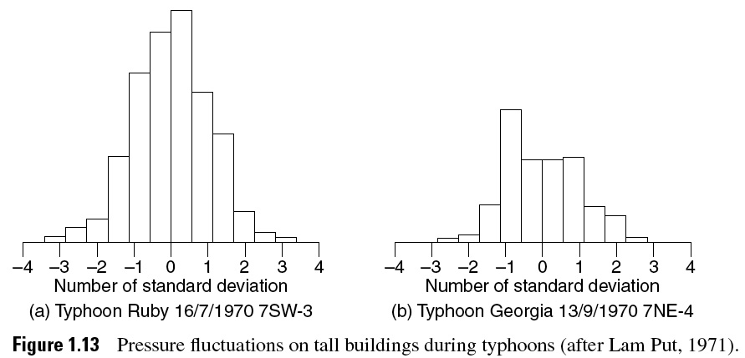
01_13
Decisions with Probability Distributions
An offshore platform is subject to occasional hurricane forces in which the wind and water wave effects, e.g., velocities, turbulence, can vary. So the probability of strong winds with intensity distributions must be considered in the design of the platform .
Such decisions require a balance between the cost and level of protection to manage the risk of life and property.
(Ang, PCE)
Notes:
01_13.jpg

Slide 15
Decision Making Under Uncertainty
Decisions about designs, engineering projects, test and maintenance strategies, or Emergency Planning, such as the offshore platform example:
Assume only worst-case conditions?: overly costly
Assume only low case conditions?: poor safety
Engineering variables are random variables
The inherent variability can be modeled and communicated in histograms, which are frequency diagrams displaying observed values

Slide 16
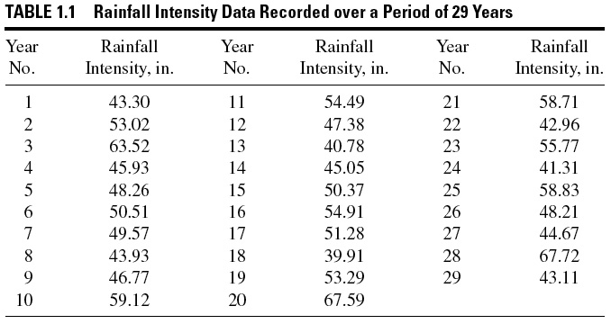
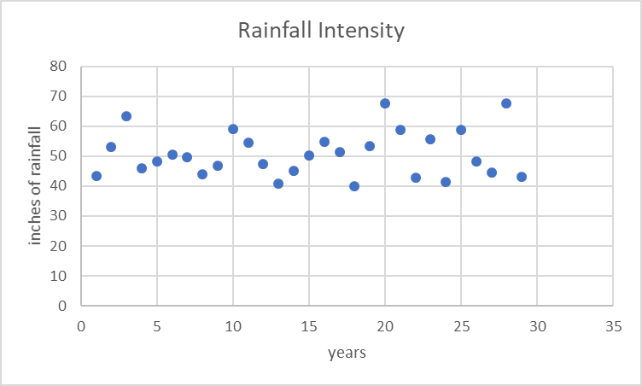
01_01tbl
Language for Analysis of Information
(Ang, PCE)
Notes:
01_01tbl.jpg

Slide 17
01_01tbl
Language for Analysis of Information
Variability or randomness in rainfall is the Aleatory Uncertainty
Sampling errors contribute to Epistemic Uncertainty due to the limitations of the number and quality of the data.
(Ang, PCE)
Notes:
01_01tbl.jpg

Slide 18
Two Types of Uncertainty
Aleatory Uncertainty arises because of the unpredictable, random nature of the physical system under study.
Due to randomness in a process
Due to fluctuations in conditions
Cannot be reduced. Can only be identified
Epistemic Uncertainty is due to the lack of knowledge of the system in respect to quantities and processes within the system
Due to model limitations
Due to limited data and knowledge, sampling error
Can be reduced through more comprehensive knowledge, by collecting more data/information
Both needs to be considered!

Slide 19
Aleatory Uncertainty
Most events studied by engineers are to an extent random and therefore uncertain and unpredictable to a degree.
The type of uncertainty due to randomness or random behavior is designated “Aleatory Uncertainty” (throw of a die) due to fluctuations of conditions.
The inherent variability in observed events or data can be displayed in distributions or histograms

Slide 20
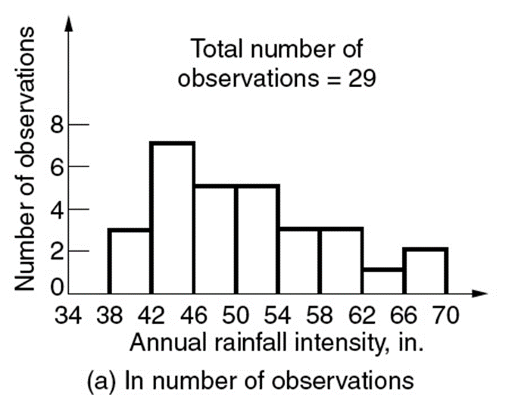
Rainfall Variability Histogram
One method is to develop histogram (for no. of observations (a) or for fractions (b))
Count the number of data points in each interval to make each column/bar
Histogram of Rainfall:
(rainfall values divided among 4in. intervals)

Slide 21


01_01
Rainfall Variability Histograms
$$\frac{no. of observations}{29}×100\%$$
(Ang, PCE)
Notes:
01_01.jpg

Slide 22
01_01
Converting to Rainfall Probability Mass Function (PMF)
These empirical frequency diagrams can be converted to empirical probability mass functions (pmf) by dividing each of the ordinates by the total area:
Total area under histogram in (a) = 29x4 = 116
Total area under histogram in (b) = 100x4 = 400
Dividing the y-axis values by total area will make the total probability under each frequency diagram = 1.
Because of normalization, the area over a given range of a pmf provides an estimate of the probability of rainfall within the range
(Ang, PCE)
Notes:
01_01.jpg

Slide 23
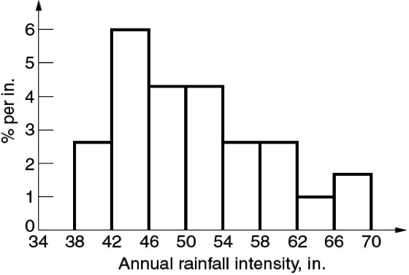
01_01c
Rainfall Probability Mass Function (PMF)
Empirical Probability Mass Function, pmf (given in percentage)
(Ang, PCE)
Notes:
01_01c.jpg

Slide 24
01_01c
Rainfall Probability Mass Function (PMF)
The area over a given range of the pmf provides an estimate of the probability of rainfall within the range.
We often require the extent of the data rather than only the mean of the data distribution, so ranges or distributions are essential
Aleatory
uncertainty
Notes:
01_01c.jpg

Slide 25
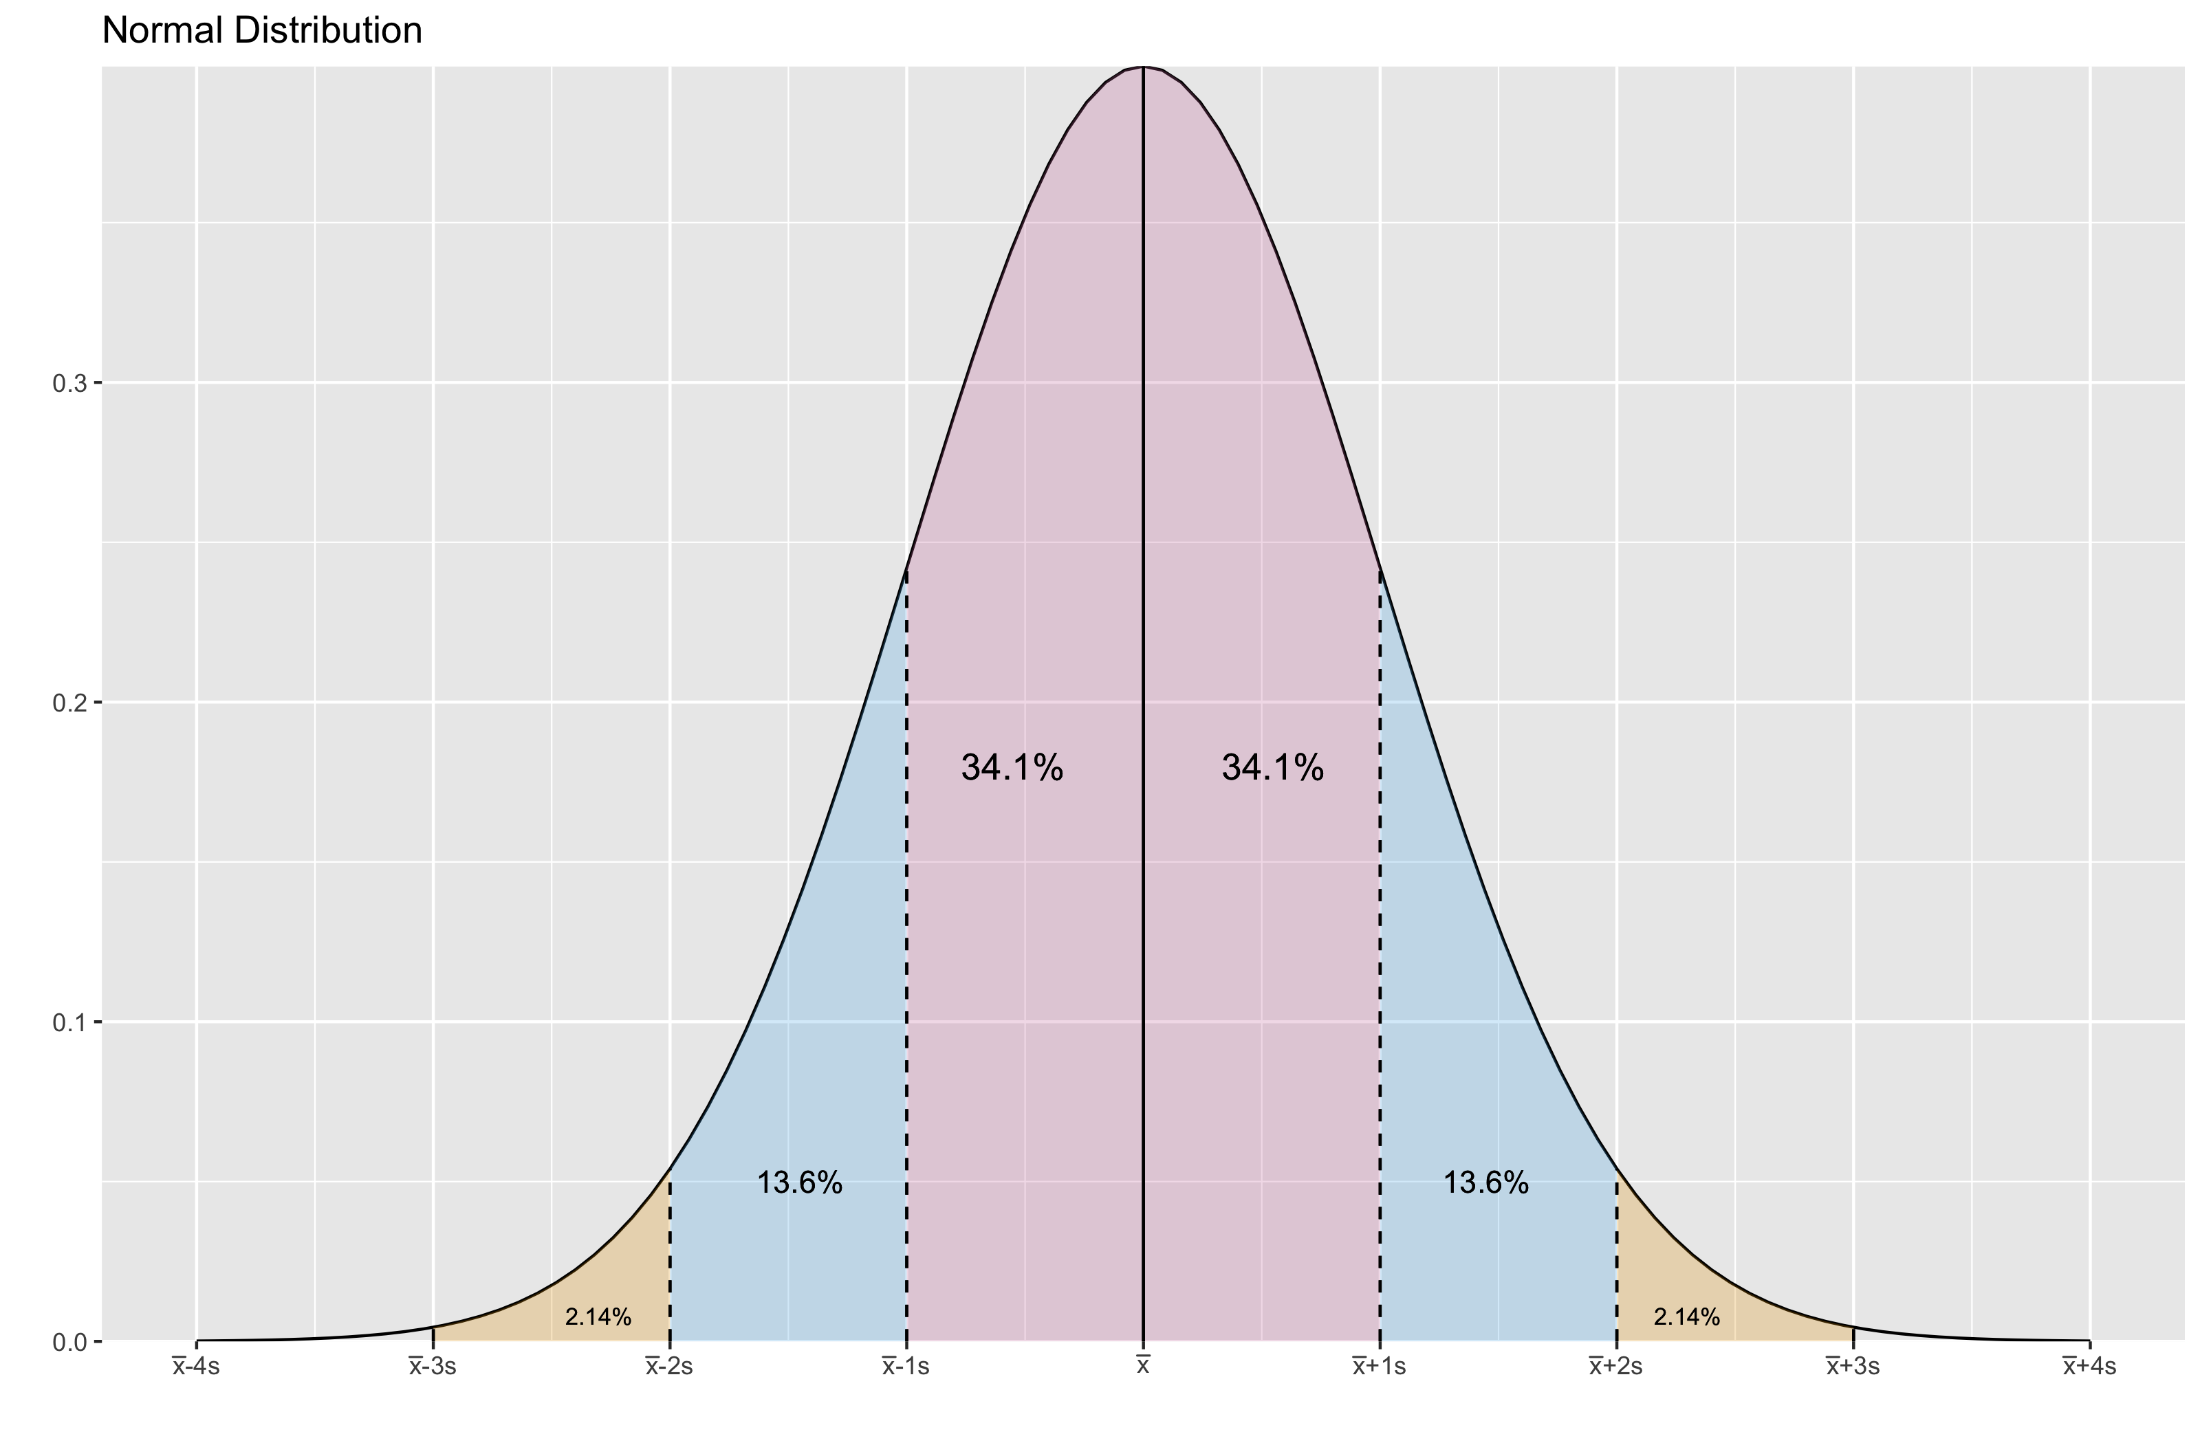
Summary of rainfall behavior
Another method is to assume that the data will fit a normal (Gaussian) distribution. You can calculate mean and variance
Sample Mean:
Sample Variance and Std. Dev.:
25

Slide 26
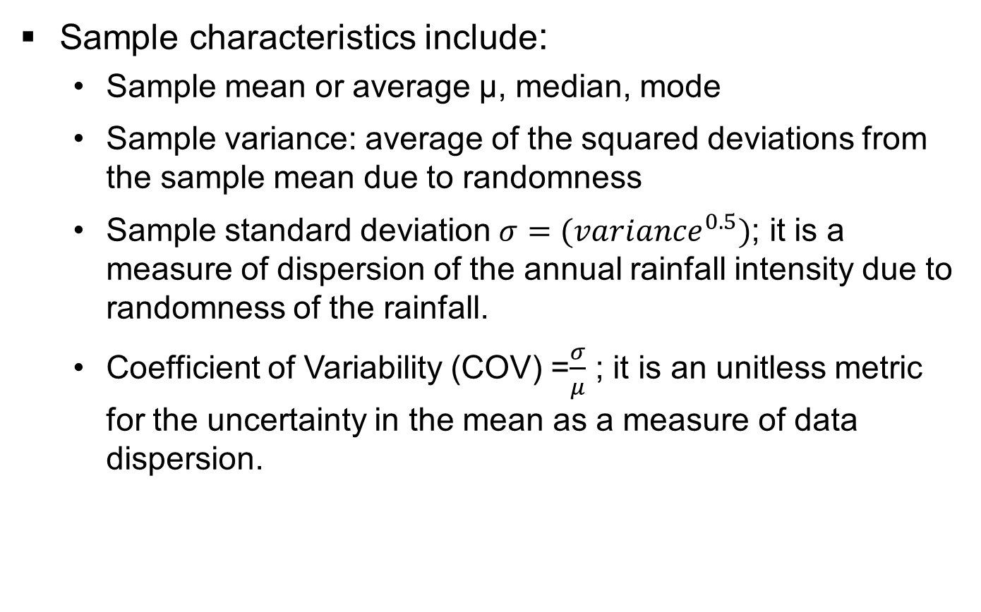
How to measure uncertainty
Sample characteristics include:
Sample mean or average μ, median, mode
Sample variance: average of the squared deviations from the sample mean due to randomness
Sample standard deviation $σ=({variance}^{0.5})$; it is a measure of dispersion of the annual rainfall intensity due to randomness of the rainfall.
Coefficient of Variability (COV) =$\frac{σ}{μ}$ ; it is an unitless metric for the uncertainty in the mean as a measure of data dispersion.
Notes:
Low COV=more precise (does not necessarily mean it is more accurate)

Slide 27
Epistemic Uncertainty
Models are idealized representations of real events and therefore are imperfect. For example the ideal gas equation of state, PV = nRT, is never true but conditionally useful and can be a good approximation near limits of low pressure
Because models are inaccurate to a degree, the analysis, estimations, and predictions based on the models are inaccurate, and they contribute to knowledge-based Epistemic uncertainty.
Uncertain data used with imperfect models and uncertain model parameters results in data uncertainty propagation to uncertainties in predicted outcome ranges and distributions.
An example in assessing the Epistemic uncertainty of a predictive model is shown in the next figure, which is a Scattergram of two random variables: the calculated and corresponding observed maximum wind speed variables.

Slide 28
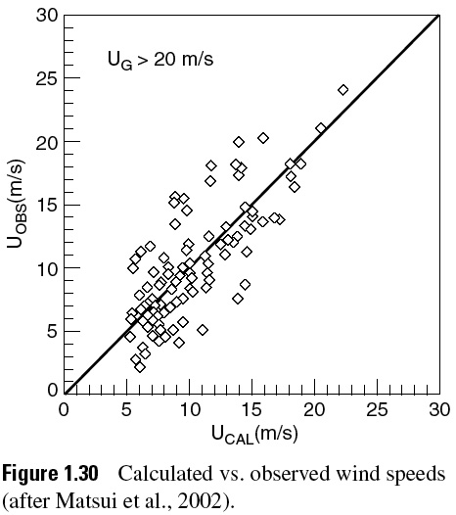
01_30
Scatterplot showing Epistemic Uncertainty due to imperfect model and data
The line models the Aleatory uncertainty in the wind speeds due to randomness of speeds over ranges of conditions.
aleatory
epistemic
With highly accurate data and an accurate model with lower Epistemic uncertainty, the points would be closer to the ~ 45 line or model curve.
(Ang, PCE)
Notes:
01_30.jpg

Slide 29
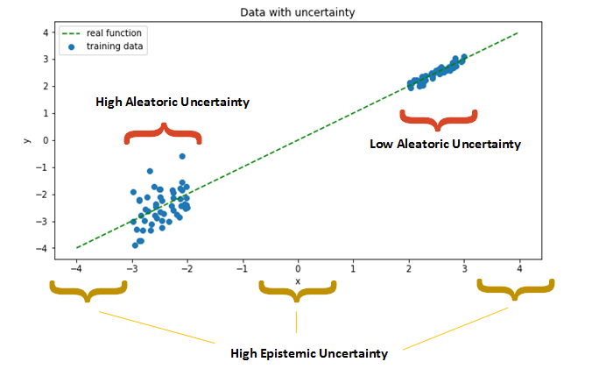
Aleatory vs. Epistemic

Slide 30
Should a Farmer Change Fertilizers?
Consider a farmer’s dilemma: A farmer compares available information of a newly developed fertilizer B that shows the predictive distribution for crop yields, θ, to follow a Normal (Gaussian) distribution and he compares it with that of an old fertilizer A, that also follows a normal distribution.
Based on all current information and test data for A and B: A: mean yield of 200 bushels/acre with σ = 20 (narrow) B: mean yield of 220 bushels/acre with σ = 49 (broad)
For an optimum fertilizer decision, the farmer needs a relevant predictive distribution for yield, θ, based on the farmer’s local conditions rather than a point (mean) value or an equally weighted range for expected yield, θ.
(Christensen, 2011)

Slide 31
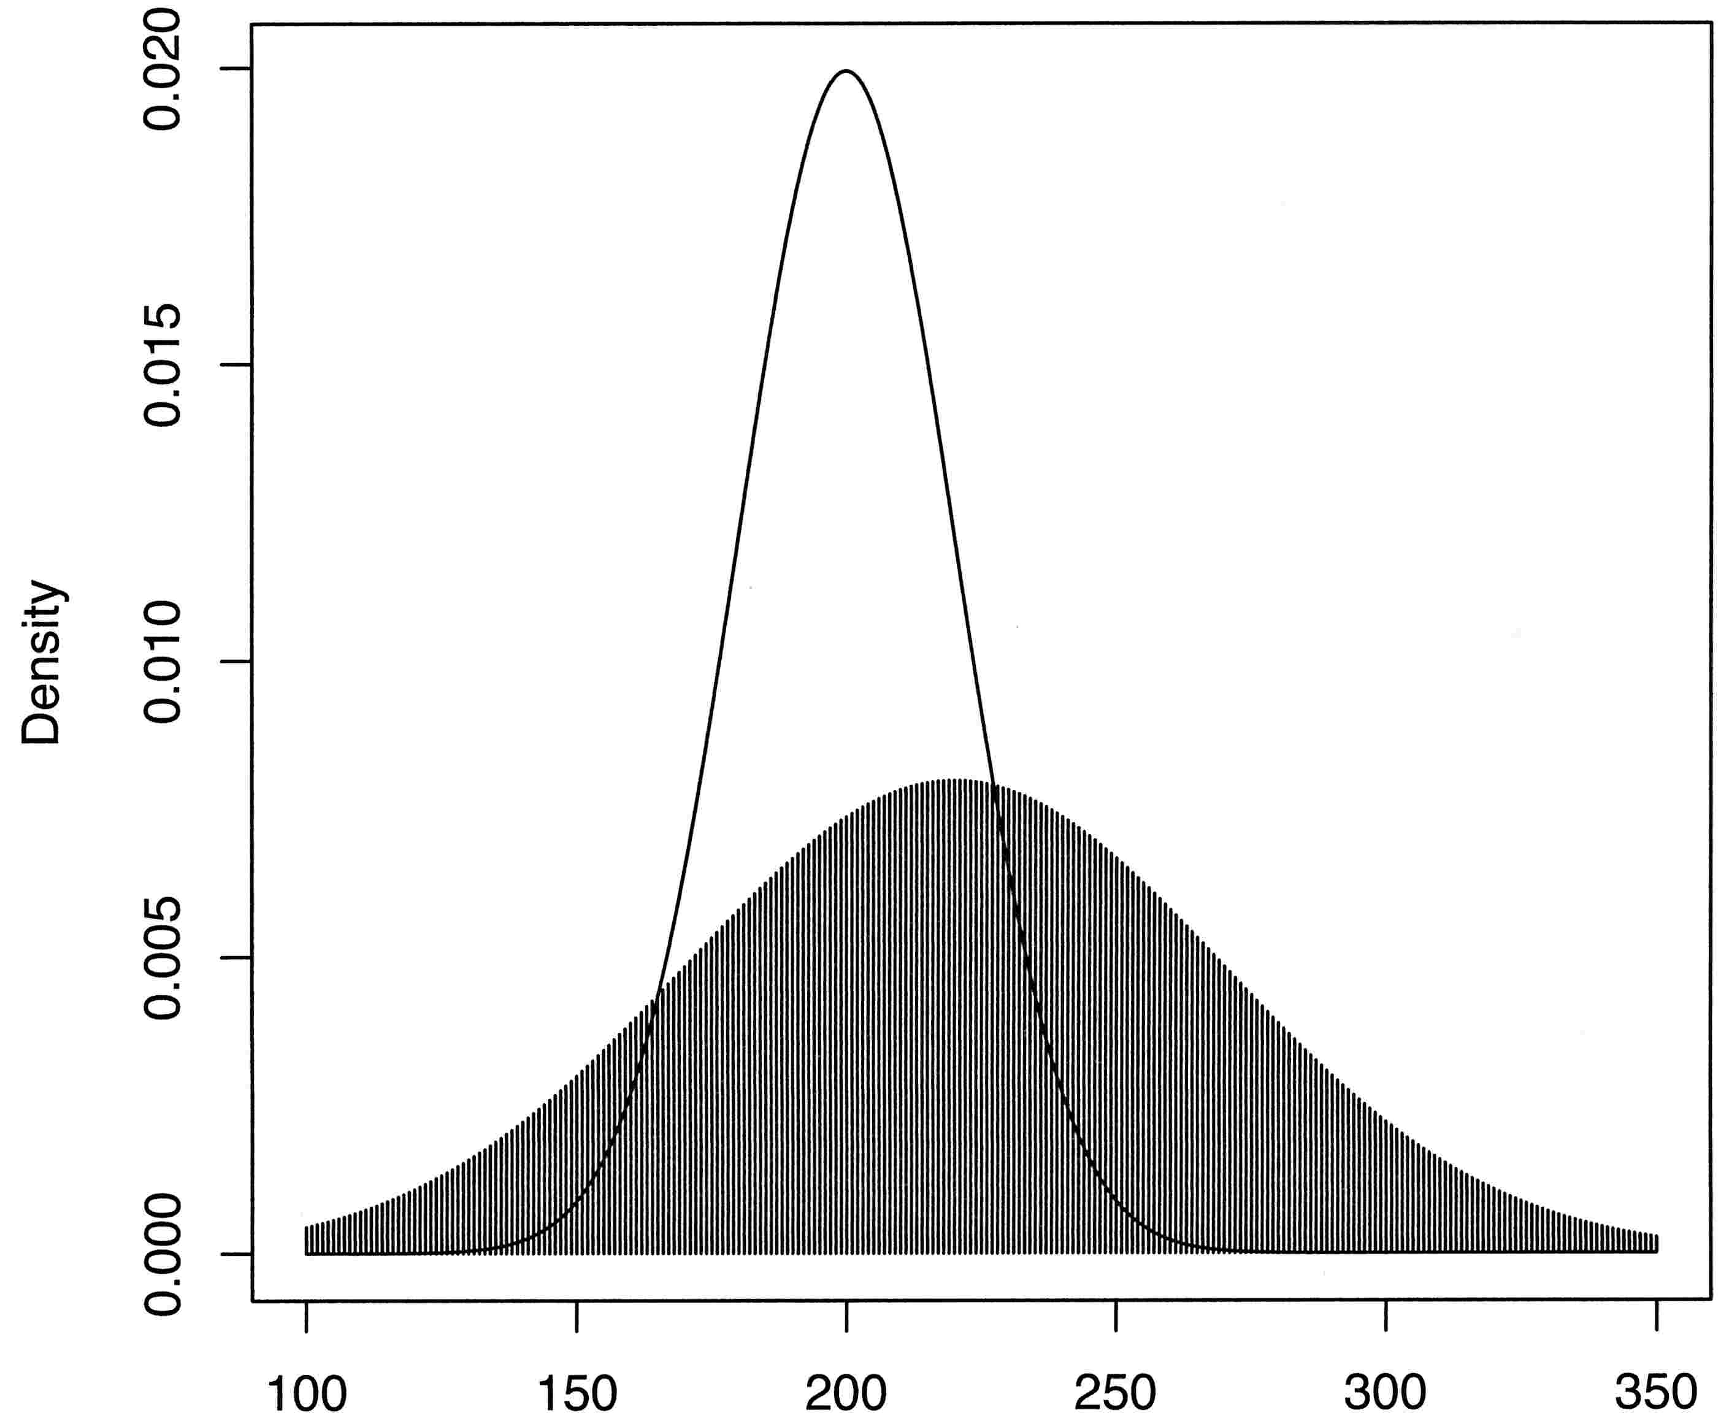
(Christensen, 2011)
A: old fertilizer
B: new fertilizer
P(A ≥ 250) = 0.006
P(A ≤ 150) = 0.006
P(B ≥ 250) = 0.27
P(B ≤ 150) = 0.08
Probability
Bankrupt
Buy combine
μ_{A}
μ_{B}
220
(Christensen, 2011)
X = Yield bushels/acre
Deciding between A and B, a farmer is better served by using all information, which shows a great difference between A, B, compared to a decision based only on mean values, which are close in value and suggest incorrectly only a small difference between A and B.
Notes:
http://onlinestatbook.com/2/calculators/normal_dist.html

Slide 32
Predictive Distributions for Both Cases
A farmer requires a yield ≥ 250 to afford a new combine. The cumulative probability for A ≥ 250 is 0.006 compared to 0.27 for B ≥ 250 (area under curve).
Therefore, a farmer who can accept greater risk might change to B with a much larger probability of a yield θ ≥ 250 to result in sufficient profit for a new combine.
To avoid bankruptcy, however, the crop yield must be ≥ 150. P(A < 150) = 0.006, but P(B < 150) = 0.08.
So a risk averse farmer would likely go with the old A fertilizer to be reasonably assured of staying in business but delaying a new combine.
(Christensen, 2011)

Slide 33
Lower uncertainty of New Fertilizer
What could be done to lower the uncertainty of θ using the new fertilizer at a particular site?
Research, given the farmer’s local field conditions, such as type of soil, farming method, weather, would lower the uncertainty of θ given the specific conditions, and narrow the predictive distribution of θ for a more realistic forecast for the farmer’s field.

